Slide 1








BUILD
भारत
2.G0
WITH
Project Title:
GhostNet
Detect. Prevent. Stay Ahead of Scams.
AI-Powered Fraud Detection & Scam Intelligence Platform
N A T I O N A L L E V E L H A C K A T H O N
T E A M N A M E : AEVION
T E A M M E M B E R S :
_{THEME:}
CYBERSECURITY
_{Problem Statement:}
Innovative Solution for Cybersecurity
Vishal Kumar Tripathi
Sidhinath Kumar
Ujjal Rizal
Aniket Chauhan
C O L L E G E :
KCC INSTITUTE OF TECHNOLOGY AND MANAGEMENT , GREATER NOIDA
भा र त 2 . 0

Slide 2


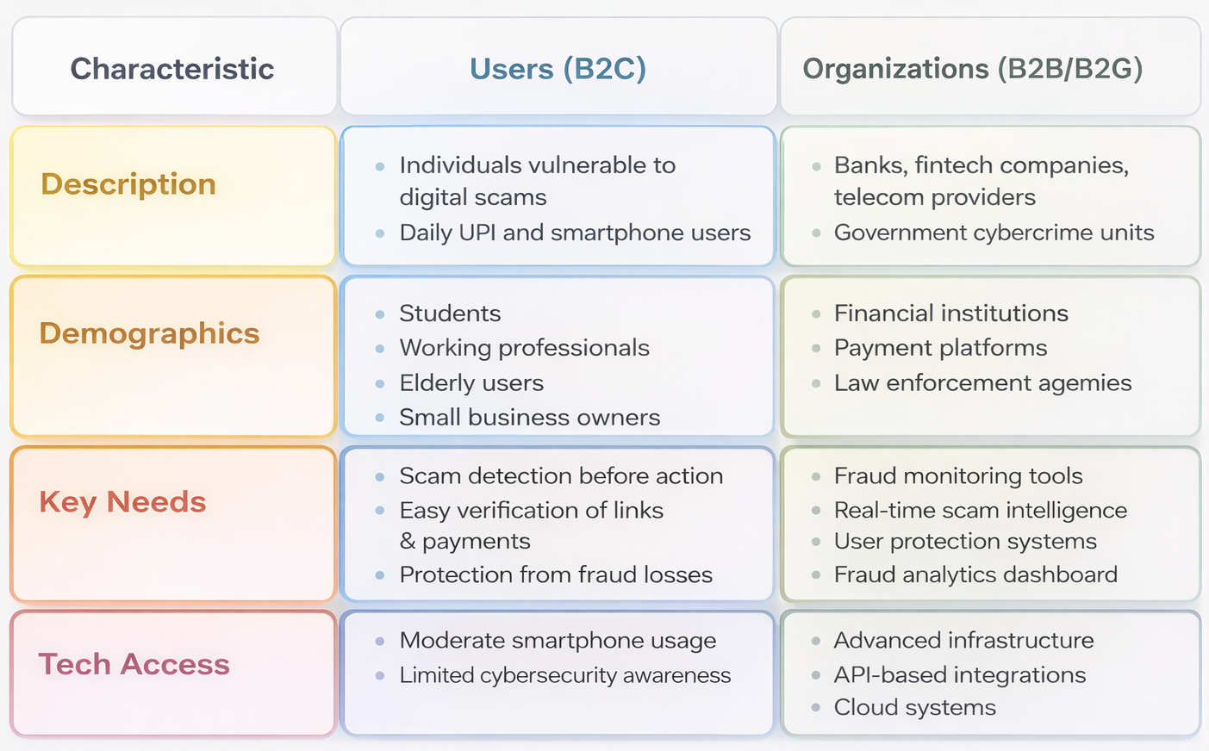
PROBLEM STATEMENT
Problem We’re Solving
India is witnessing a sharp rise in digital fraud, with UPI and online scams costing users thousands of crores annually.
Phishing links, fake payment screenshots, and scam messages exploit urgency and trust, leading to widespread financial losses.
Users lack a real-time, unified system to verify links, UPI IDs, or messages before acting, making them highly vulnerable to scams.
llablabeot Causes
🧠 Low awareness & psychological manipulation
🔗 Lack of real-time verification systems
🧩 Fragmented security solutions
🌐 Rapid growth of digital payments (UPI exposure)
🖼️ Advanced scam techniques (fake screenshots, phishing)
भा र त 2 . 0

Slide 3
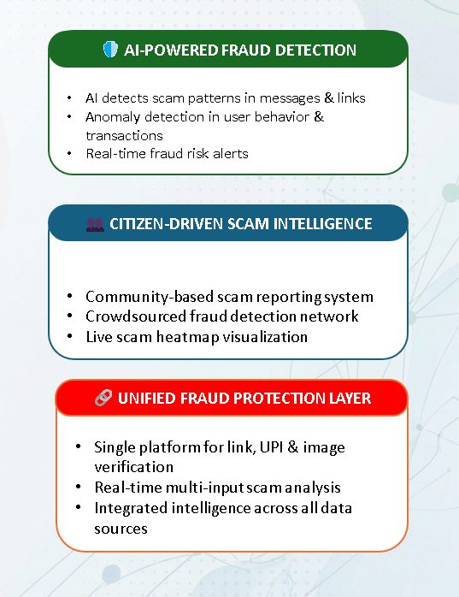
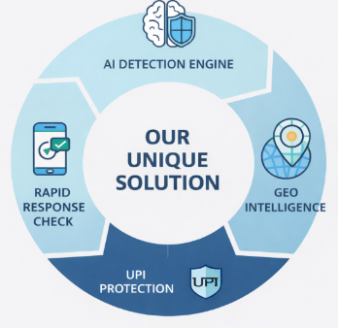





SOLUTION
OUR UNIQUE SOLUTION AI-Powered Fraud Detection & Scam Intelligence Platform
OWERED FRAUD DETECTION
🚨 THE PROBLEM:
₹10,000+ Cr lost annually to digital scams 13L+ cybercrime cases reported yearly No real-time scam verification system Rising phishing, fake UPI & screenshot fraud
Prevents ₹10,000+ Cr annual fraud losses
Protects 300M+digital payment users
Real-time detection across SMS, links, UPI & images
Up to 90–95% fraud detection accuracy
भा र त 2 . 0

Slide 4
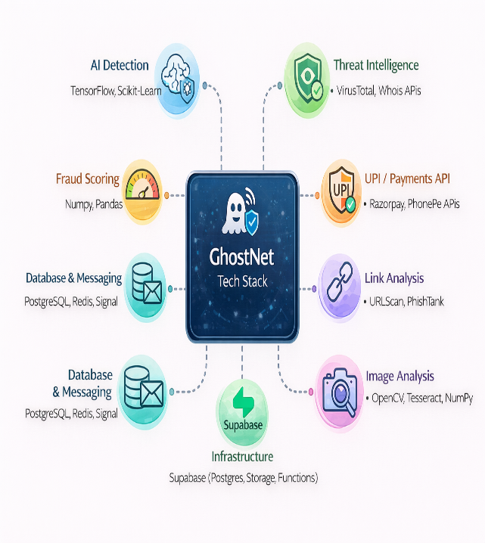

TECH STACK
भा र त 2 . 0

Slide 5


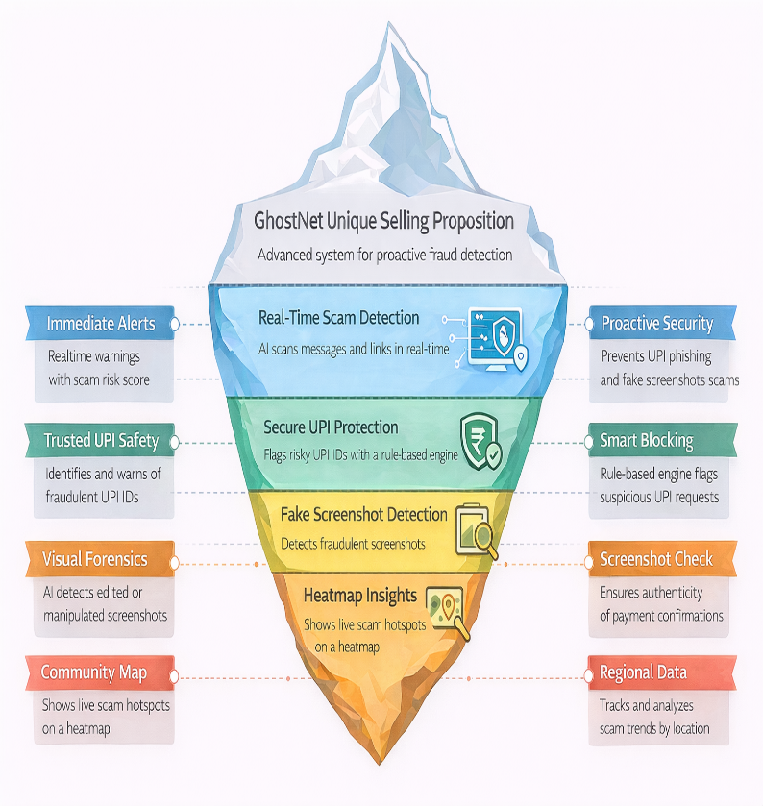
UNIQUE SELLING PROPOSITION (USP)
भा र त 2 . 0

Slide 6
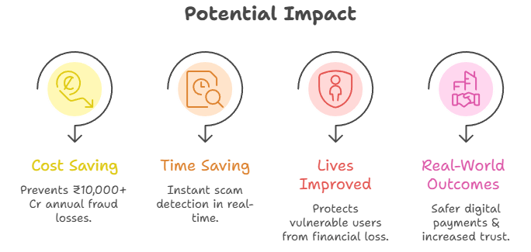
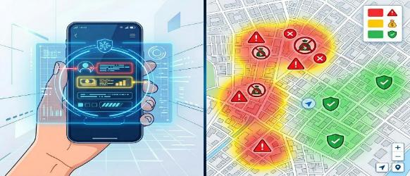
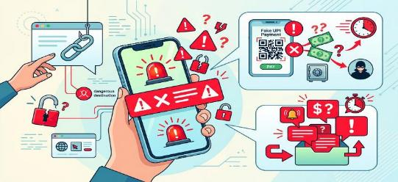
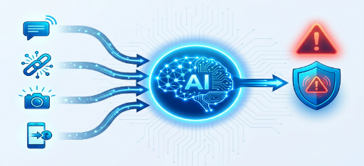
IMPACT & FUTURE
भा र त 2 . 0

Slide 7
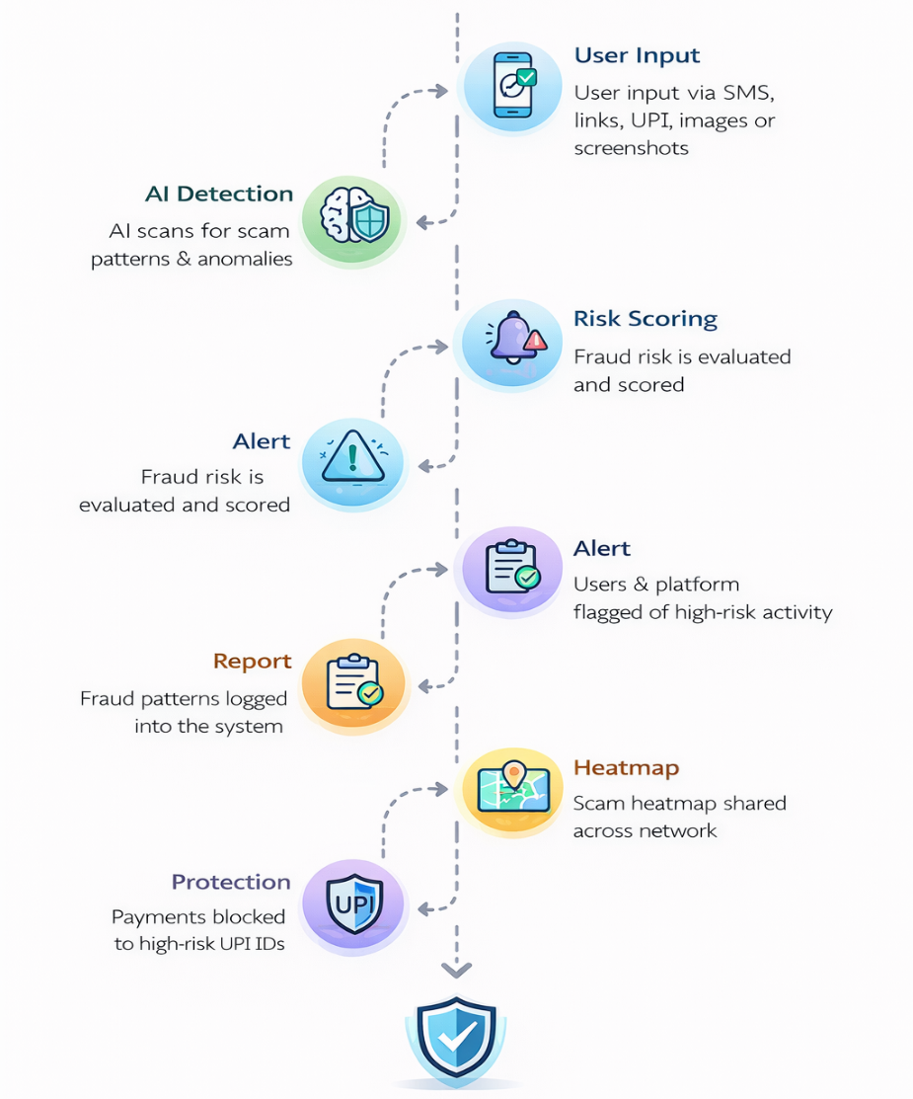
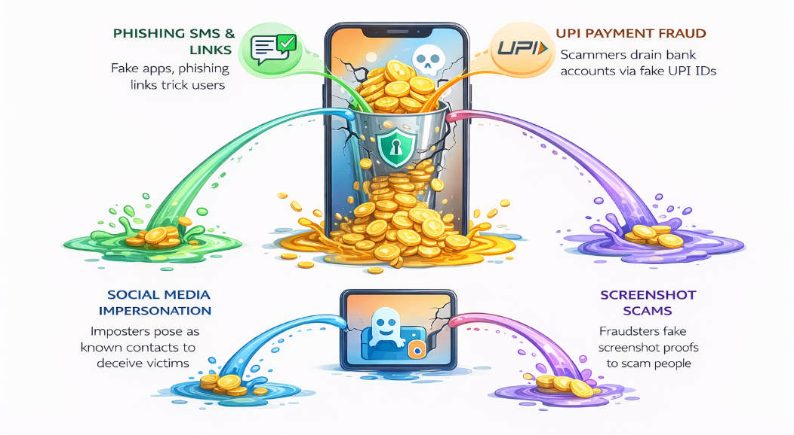

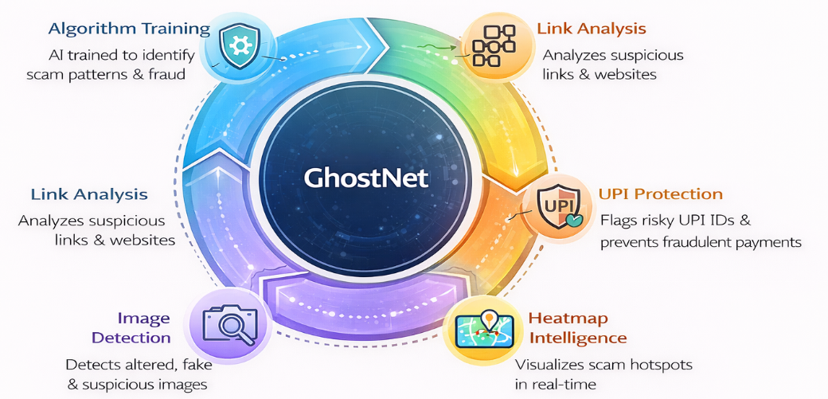

F E A S I B I L I T Y , C H A L L E N G E S & C O M P E T I T O R A N A L Y S I S
भा र त 2 . 0

Slide 8
R E F E R E N C E S , G I T H U B R E P O S I T O R Y & D E M O L I N K
I4C & National Cyber Crime Reporting Portal (Govt of India - Helpline 1930)
MITRE ATT&CK® Matrix for Enterprise & Phishing Techniques
Google Gemini Vision 1.5 & Groq LPU Inference Documentation
CERT-In Advisory on Social Engineering & UPI Digital Arrest Scams
Supabase Architecture & Row-Level Security (RLS) Best Practices
📚 RESEARCH, DATASETS & OFFICIAL REFERENCES
🌐 LIVE DEMO WEB APP
📦 GITHUB REPOSITORY &
SOURCE CODE
Live Web Application: https://ghost-net-zeta.vercel.app/
Mobile APK: Native Android Build (Capacitor 8 Mobile Shell)
Interactive Features:
Threat Reconstruction™ 5-Stage Attack Kill-Chain
"What Happens If I Click?" Zero-Execution Sandbox
1-Tap Senior & Family Safety Mode
Global Scam Telemetry & Heatmap Radar
Repository: https://github.com/ImperialCoder01/GhostNet
Tech Stack: React 18 + Vite 6 + Tailwind CSS + Capacitor 8 Android
AI Pipeline: Groq LPU (Sub-250ms NLP) + Google Gemini Vision OCR
Backend & DB: Vercel Edge Serverless + Supabase PostgreSQL (RLS)
भा र त 2 . 0

Slide 9

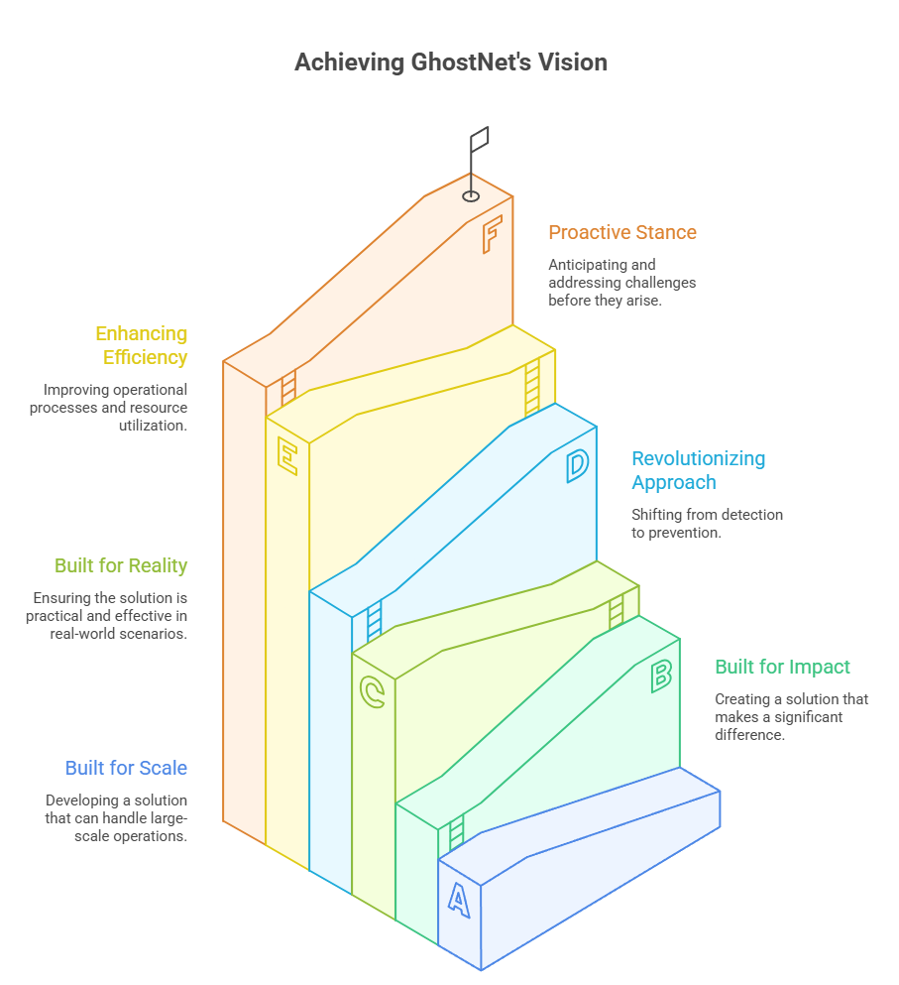
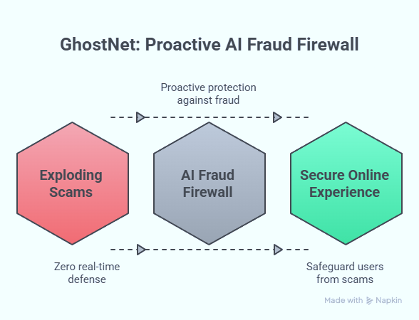

CONCLUSION
The Problem Exploding scams, zero real-time defense.
Our Solution
Built for scale, built for impact, built for reality
भा र त 2 . 0

